Slide 1


RESEARCH PROJECT
Retail Price Prediction Using ML and DL Algorithms
24 Furkan Mistry
19 Mandar Tarmale

Slide 2


Introduction
Retail pricing is the process of setting prices for products sold to customers, influenced by factors such as competition, demand, and costs.
It is crucial for businesses to find the right price to attract customers while ensuring profitability.
Dynamic retail markets often experience frequent price changes, making pricing strategies more complex.
Predictive models, like those using machine learning and deep learning, help analyze trends and customer behavior to suggest optimal prices.
Effective pricing strategies can increase revenue, improve market competitiveness, and enhance customer satisfaction.

Slide 3


PROBLEM STATEMENT
Retail pricing is a complex and dynamic process affected by several factors such as customer preferences, market trends, competitor actions, and product-specific attributes.
Traditional pricing models often fall short because they rely on strong assumptions and static equations, failing to capture real-world complexities.
These challenges are particularly pronounced in e-commerce platforms where sellers must account for variables like item condition, brand recognition, and shipping options.
This challenges highlights the need for efficient, data-driven solutions to improve pricing accuracy, and speed in predicting optimal retail prices.

Slide 4
Literature Review
In prior studies, various techniques have been developed to optimize retail pricing using machine learning and deep learning approaches.
Dynamic Pricing for Retail: A Linear Regression Approach (Zhang, Yifan, Wei, Chen, & Liu, Anna)
Enhancing Retail Price Optimization Strategies for Improved Performance
(Belovedinla L.G and A. Revathi).
Improving Sales Prediction for Point-of-Sale Retail Using Machine Learning and Clustering (Chibuzor U., Patrick B., Farzaneh D., and Taha F.)

Slide 5
Dataset Description
Dataset:
The secondary data used for this study is sourced from the Kaggle website.
The dataset used for model training consists of product listing data from the Mercari marketplace.
The dataset contains 1,482,535 rows and 8 columns.
It includes various attributes such as item condition, category, brand, price, shipping details, and item descriptions.
Each product listing has been evaluated for its price, with the target variable being the price at which the item was sold.
The dataset provides a comprehensive representation of products across different categories, allowing the model to learn pricing patterns and optimize retail prices based on the features available.
Feature | Description
train_id / test_id | Unique identifier for each product listing.
name | Title of the listing
item_condition_id | Indicates the condition of the item.
category_name | The category the product belongs to (e.g., electronics, clothing).
brand_name | The brand associated with the product.
price | The price at which the item was sold (target variable, available only in the training set).
shipping | Shipping fee indicator: 1 for seller-paid shipping, 0 for buyer-paid shipping.
item_description | A textual description of the item, with price-like text removed to ensure data integrity.

Slide 6
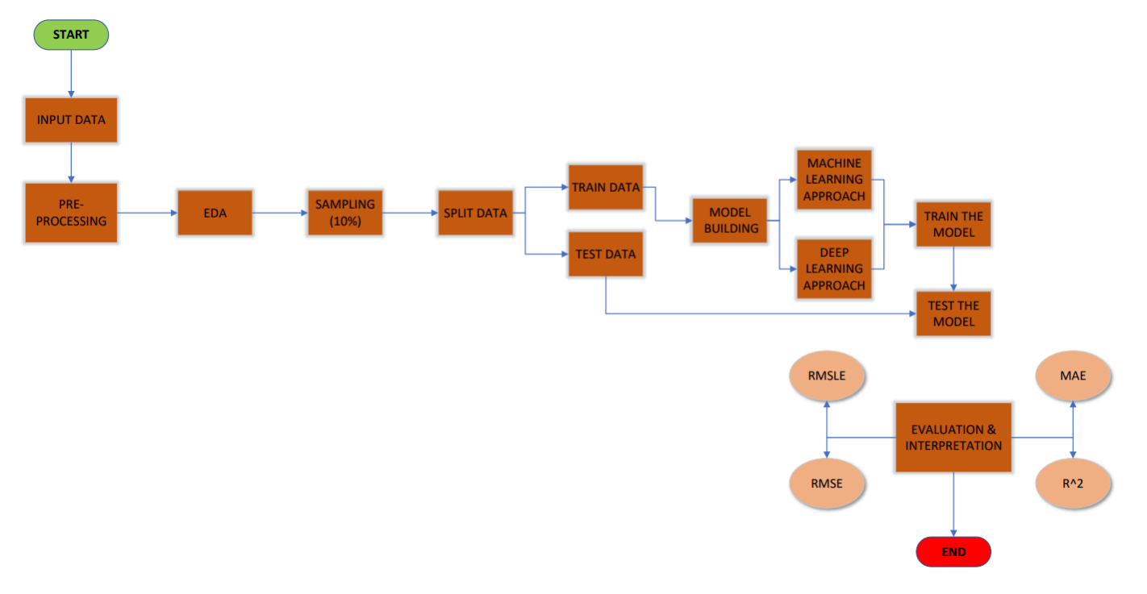
METHODOLOGY/PROCESS-FLOW

Slide 7
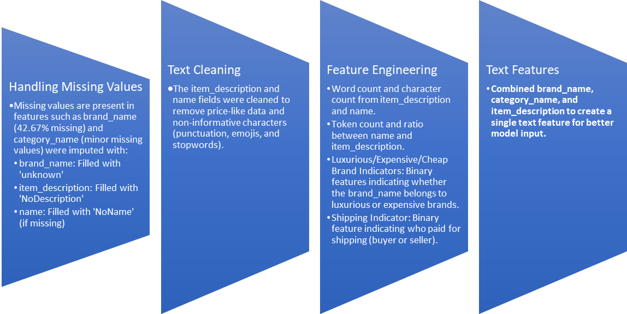
Preprocessing & Data Analysis
Encoding
One-hot encoding is applied to feature like category_name and shipping to convert them into numerical format.
Binary encoding is applied to feature like is_expensive and is_luxourious to create a binary column.
Outlier Removal
Extreme price values below $3 and above $2000 were identified and remove to ensure reliable model training.
Text Handling for missing values
The combined text feature ( from brand_name, and item_description) helps manage missing data by treating placeholders like "Unknown" as valid tokens during tokenization, avoiding bias in the model.

Slide 8
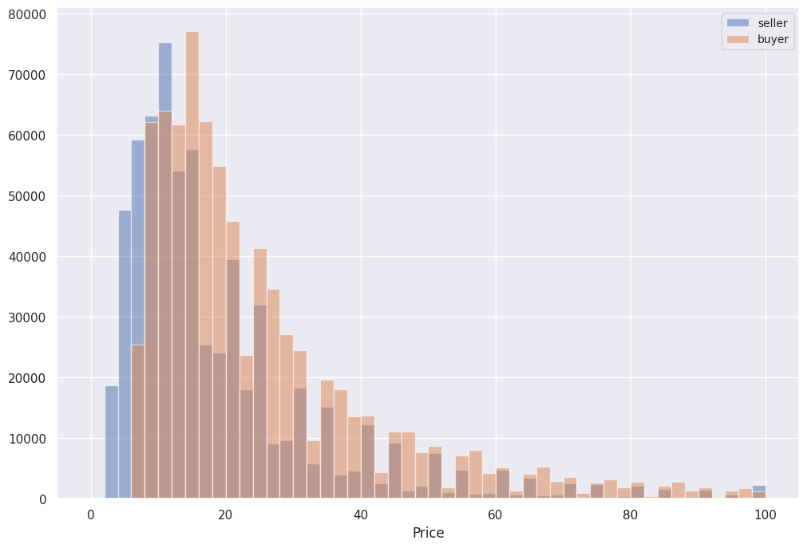
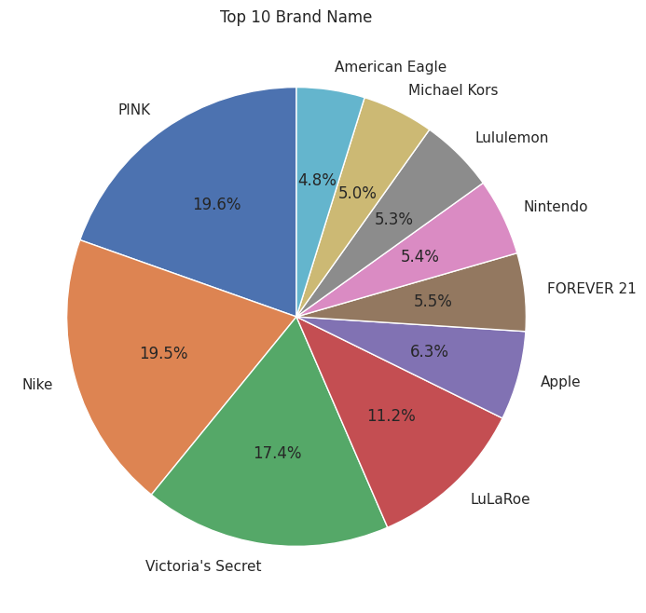
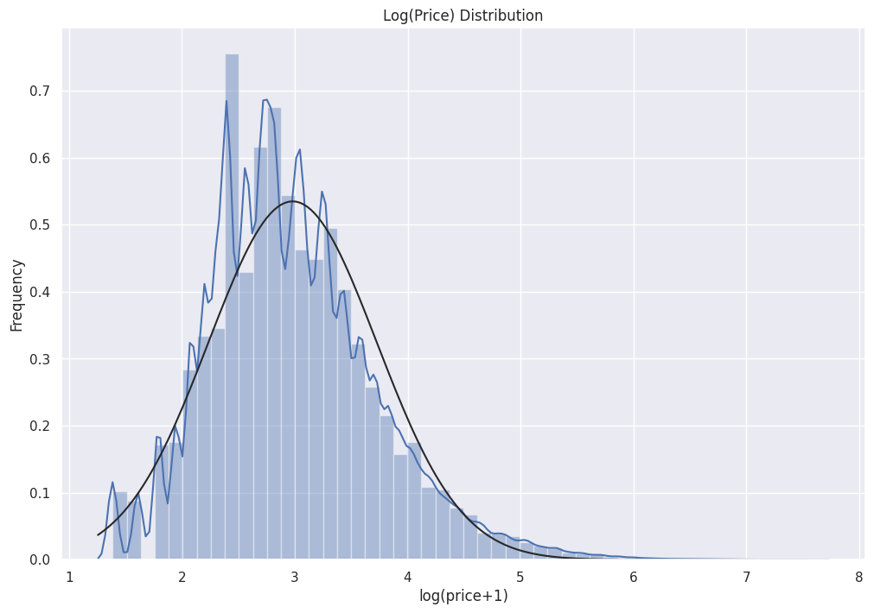
Exploratory Data Analysis
Price Distribution:
The price distribution was positively skewed. A log transformation helped normalize the distribution, making the data more suitable for modeling.
Brand Analysis:
Items from recognized brands generally had higher prices. There were 4,807 unique brands, with high-end brands showing a strong influence on price.
Shipping Analysis:
Items where the seller pays for shipping tended to have higher prices. Shipping was also found to impact price distribution.

Slide 9
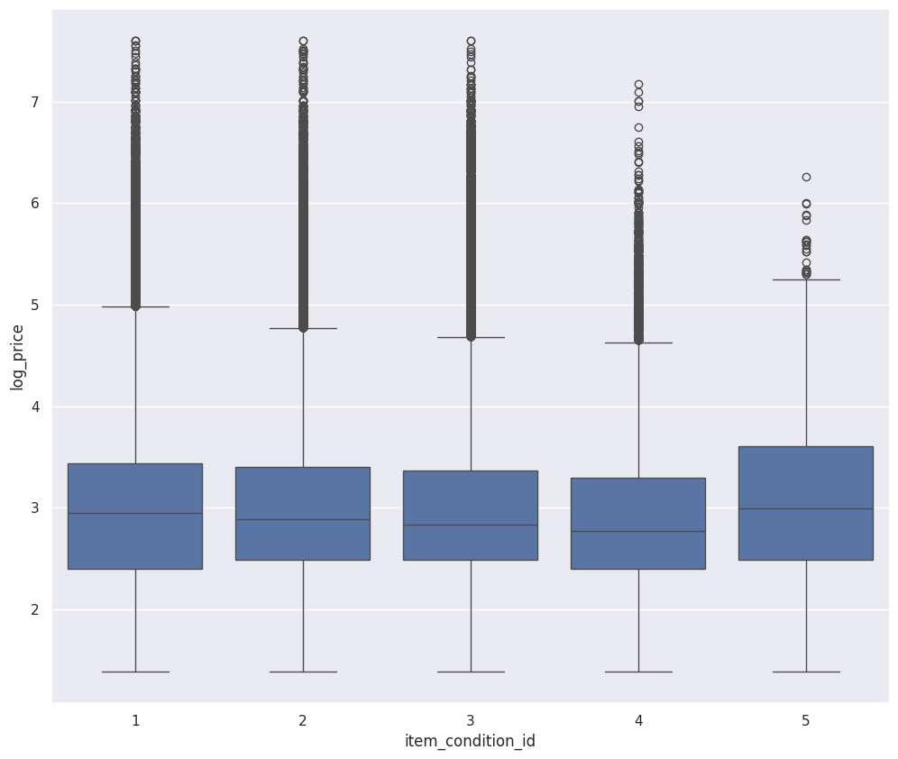
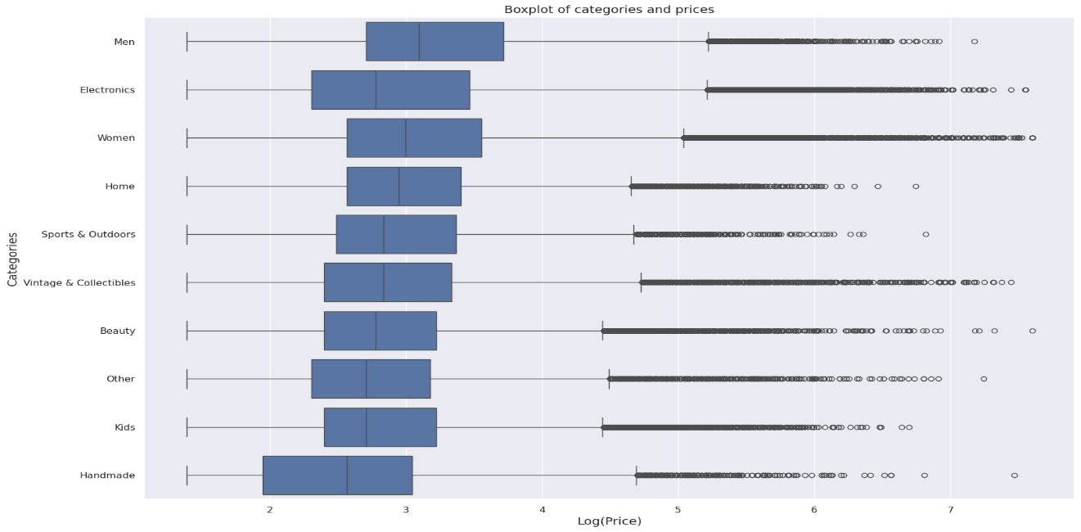
Exploratory Data Analysis
Category Analysis:
Some product categories (e.g., Electronics) had higher average prices, while others (e.g., Handmade items) had lower prices.
Item Condition:
Products in better condition (lower item_condition_id) generally had higher prices, though there were exceptions based on brand and category.

Slide 10
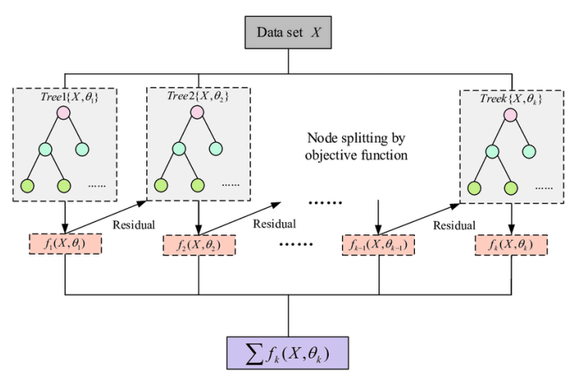
Model Building
XGBoost Model Architecture:
Gradient Boosting Trees: XGBoost utilizes an ensemble of decision trees where each tree corrects the errors made by the previous one.
Base Learner: Each decision tree serves as the base learner, and XGBoost applies boosting to reduce bias and variance.
Objective Function: The model is trained to minimize a loss function using both regularization and gradient descent techniques.
Model Output: The final output is a continuous predicted price, optimized to minimize metrics like RMSLE and RMSE.
Feature Importance: XGBoost also provides insights into feature importance, helping to understand which features (e.g., item condition, brand, shipping) have the greatest impact on price predictions.

Slide 11
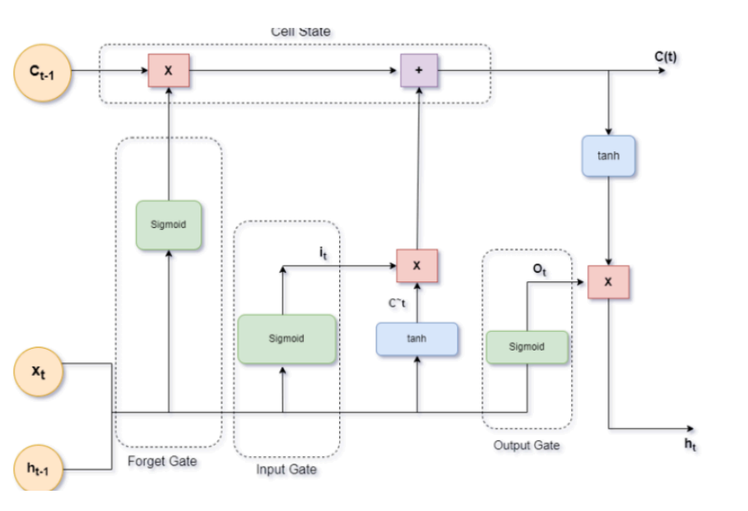
Model Building
LSTM Model Architecture:
Sequential Data Processing: LSTM processes sequential data like item descriptions, capturing long-range dependencies in the text.
LSTM Cells: The architecture consists of input, forget, and output gates that allow the model to selectively remember and forget information over time.
Fully Connected Layers: After the LSTM layers, the output is flattened into a one-dimensional tensor and passed through fully connected layers for further processing.
Activation Function: The model uses a sigmoid activation function in the output layer to predict a continuous price value.
Model Output: The final output is the predicted retail price, optimized based on performance metrics such as MAE and MAPE.

Slide 12
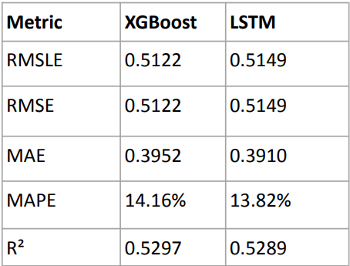
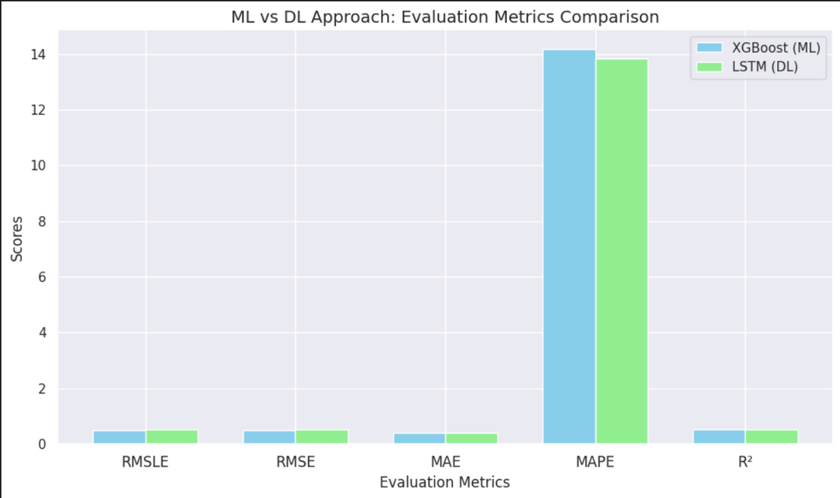
RESULTS AND DISCUSSION
Performance Metrics: RMSLE, RMSE, MAE, MAPE, R².
XGBoost: Higher R² and RMSLE scores.
LSTM: Better handling of text-based features.

Slide 13
Conclusion
This study demonstrates the effectiveness of machine learning and deep learning models, specifically XGBoost and Long Short-Term Memory (LSTM) networks, in predicting optimal retail prices for products on the Mercari marketplace.
Findings:
XGBoost outperforms LSTM in handling structured data, efficiently capturing relationships between features like item condition, brand, and category.
LSTM excels in modeling text-based complexities, such as item descriptions, which enhances pricing predictions.
Performance Metrics:
Both models were evaluated using RMSLE, RMSE, MAE, MAPE, and R². XGBoost achieved better results in RMSLE and R², while LSTM demonstrated competitive performance, particularly in MAPE.
Implications:
Both models provide data-driven pricing recommendations, enabling dynamic pricing strategies to help sellers optimize their prices.
These models can improve competitiveness on e-commerce platforms by making pricing decisions more responsive to market trends and customer preferences.
The findings suggest that leveraging these models can lead to better sales performance and profitability in a dynamic retail environment.

Slide 14

Future Enhancement
Focus Area: This study focuses on Mercari, analyzing product listings to optimize pricing strategies.
Feature Limitations:
The analysis is restricted to available dataset features like item condition, category, brand, and shipping information.
Future enhancements could include augmenting the dataset with additional features like temporal trends, user demographics, and competitive pricing for improved predictions.
Generalizability: Findings are specific to Mercari’s marketplace and may not extend to other e-commerce platforms or regions beyond Japan.
Future Directions:
1)Incorporate temporal and geographic data for broader applicability.
2)Expand analysis to other marketplaces with diverse pricing dynamics.
3)Broaden the scope to include datasets from different e-commerce platforms and
geographic regions for generalization.

Slide 15
References
Applying Machine Learning in Retail Demand Prediction—A Comparison of Tree-Based Ensembles and Long Short-Term Memory-Based Deep Learning - Mehran Nasseri, Taha Falatouri, Patrick Brandtner, Farzaneh Darbanian
Supply Chain Demand Forecasting and Price Optimisation Models with Substitution Effect - Keun Hee Lee, Mali Abdollahian, Sergei Schreider, Sona Taheri
Retail Demand Forecasting: A Comparative Study for Multivariate Time Series - Md Sabbirul Haque, Md Shahedul Amin, Jonayet Miah
Improving Sales Prediction for Point-of-Sale Retail Using Machine Learning and Clustering - Chibuzor Udokwu, Patrick Brandtner, Farzaneh Darbanian, Taha Falatouri
Enhancing Retail Price Optimization Strategies for Improved Performance - Belovedinla L.G and A. Revathi
Markdowns in E-Commerce Fresh Retail: A Counterfactual Prediction and Multi-Period Optimization Approach - Junhao Hua, Ling Yan, Huan Xu, Cheng Yang
Forecasting Retail Sales for Furniture and Furnishing Items through the Employment of Multiple Linear Regression and Holt–Winters Models - Melike Nur İnce, Çağatay Taşdemir
Retail Sales Forecast Based on Machine Learning Methods - Siti Syafiqah Mohd Salleh, Moong Lye Loo, Michael Christian
Analyze the Growth Rate of Price using Machine Learning - Yuxiao He
Dynamic Pricing for Retail: A Linear Regression Approach - Zhang, Yifan, Wei, Chen, & Liu, Anna

Slide 16

Thank you!
Do you have any questions?

